Slide 1
Gene Duplication and Read Mapping
Week 7
Department of CSE, DIU

Slide 2
CONTENTS
Mutation
Gene Duplication
Read Mapping
- Keyword Tree
- Suffix Tree
- Suffix Array
- Burrows Wheeler Transform

Slide 3
1. DNA Mutation
What and how mutation occurs, common forms

Slide 4
Mutation
DNA Mutation refers to sudden, random changes in DNA sequences which leads to different phenotypic expressions.
A T C C G A A T G C C G A
Insertion

Slide 5
Common Mutation Types
Substitution AATTCGCA AATGCGCA
Duplication AATCGCA AATCATCGCA
Inversion AATCGCA AACGGCA AGCATCG ACTATCG
Deletion AATTCGCA AATCGCA
Insertion AATCGCA AATTCGCA

Slide 6
2. Gene Duplication
Duplication of Genes, Homolog, Ortholog, Paralogs

Slide 7
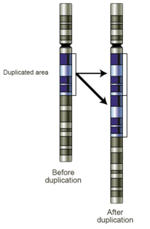
Gene Duplication
Gene duplication (or chromosomal duplication or gene amplification) is a major mechanism through which new genetic material is generated during molecular evolution. It can be defined as any duplication of a region of DNA that contains a gene.

Slide 8
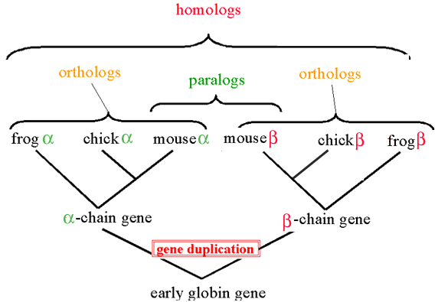
Homolog, Ortholog, Paralog and Speciation
Homolog - A gene related to a second gene by descent from a common ancestral DNA sequence
Ortholog - Orthologs are genes in different species that evolved from a common ancestral gene by speciation*
Paralog - Paralogs are genes related by duplication within a genome
Speciation* - Speciation is the origin of a new species capable of making a living in a new way from the species from which it arose

Slide 9
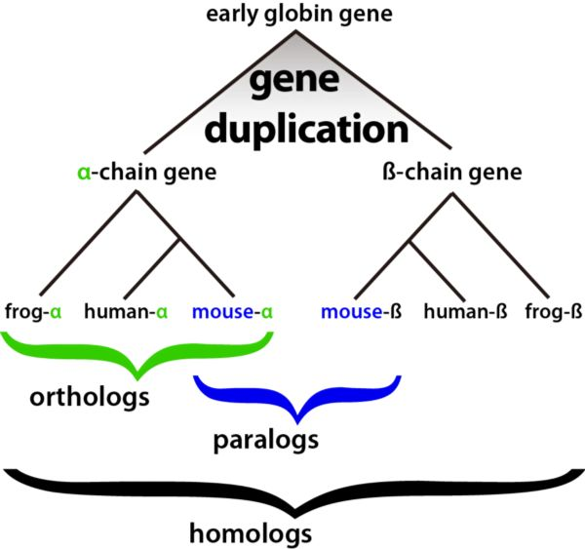

Slide 10
3. Read Mapping
Short Read Mapping, Genome Indexing

Slide 11
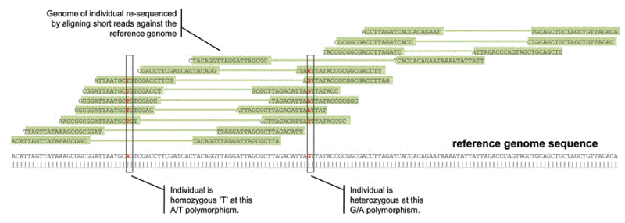
Read Mapping
Mapping refers to the process of aligning short reads to and finding the starting position in a reference sequence (typically Genome).
Short read generally are reads with a length of 30-350 base pairs.

Slide 12
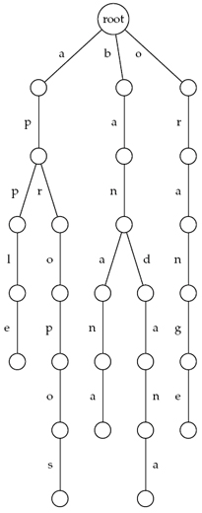
Genome Indexing (Keyword Tree)
Stores a set of keywords in a rooted labeled tree.
Each edge is labeled with a letter from an alphabet.
Any two edges coming out of the same vertex have distinct labels.
Every keyword stored can be spelled on a path from root to some leaf.
Furthermore, every path from root to leaf gives a keyword.
Keywords
Apple
Apropos
Banana
Bandana
Orange

Slide 13
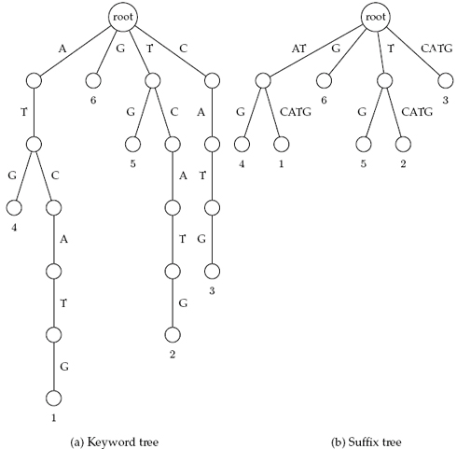
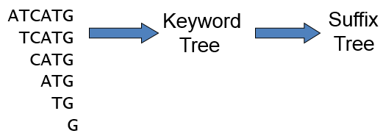
Genome Indexing (Suffix Tree)
Similar to Keyword Tree
Suffixes of the text are keywords
Edges that form paths are collapsed
Each edge is labeled with a substring of the text
All internal edges have at least two outgoing edges.
Leaves are labeled by the index of the pattern.
Suffix tree of ATCATG

Slide 14
Genome Indexing (Suffix Array)
More space efficient than suffix tree
Suffix tree index for human genome is about 47 GB
Lexicographically sort all the suffixes
Store the starting indices of the suffixes along with the original string
1 | ATCATG$
2 | TCATG$
3 | CATG$
4 | ATG$
5 | TG$
6 | G$
7 | $
7 | $
1 | ATCATG$
4 | ATG$
3 | CATG$
6 | G$
2 | TCATG$
5 | TG$
Sort the suffixes
lexicographically
Generate Suffix Array of ATCATG

Slide 15
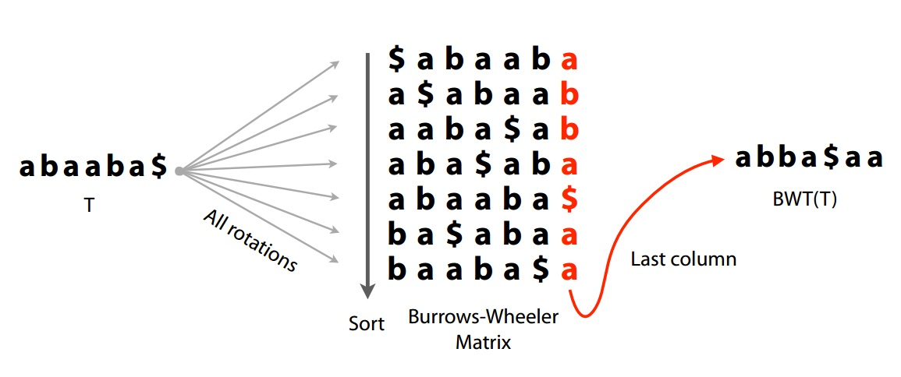
Genome Indexing (Burrows Wheeler Transform)
Given Sequence – abaaba
Add $ as ending notation – abaaba$
By Shifting each alphabet to the right once, generate all the rotations
Lexicographically Sort all the rotations
The very last column will be denoted as BWT (T)

Slide 16
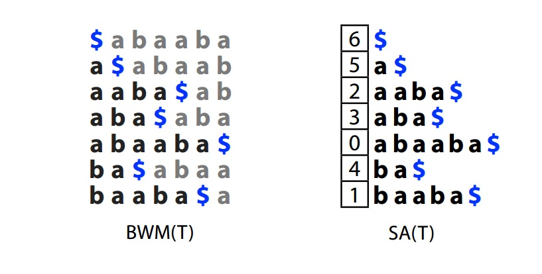
Genome Indexing (Burrows Wheeler Transform)
Given Sequence – abaaba
Add $ as ending notation – abaaba$
Lexicographically sorted all rotations will generate BWT Matrix which will be denoted as BWM (T)
Suffix Array generated from all the rotations will be called SA (T)
BWM can be derived from any given BWT (T)

Slide 17
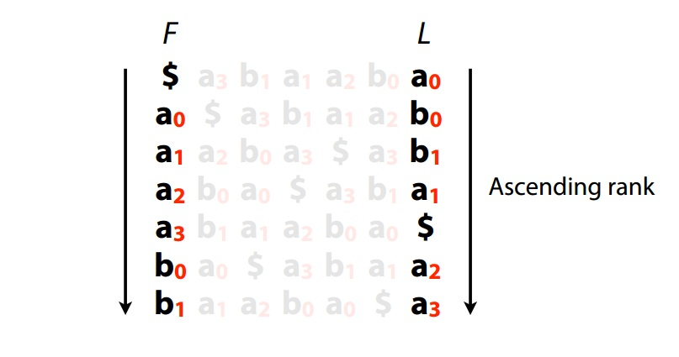
Genome Indexing (Burrows Wheeler Transform)
LF (Last to First) Mapping
Generate Burrows Wheeler Matrix for a given sequence
Assign numbers to distinguish same characters
Assign the numbers in a ascending manner for each character

Slide 18
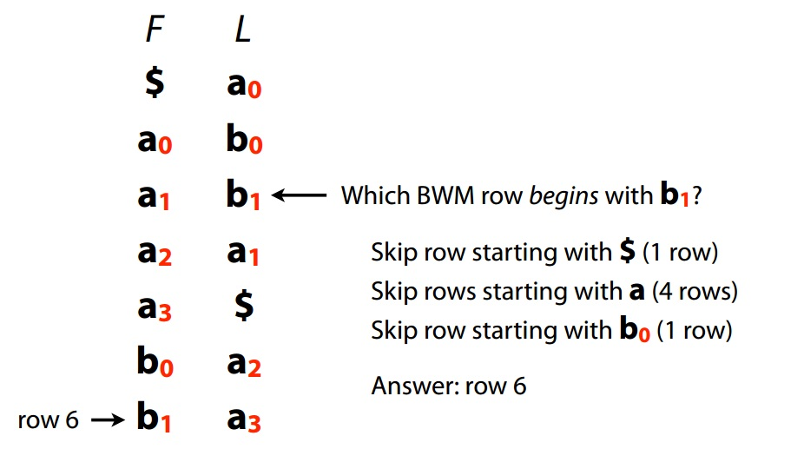
Genome Indexing (Burrows Wheeler Transform)
Find out the row starting with b1 using LF Mapping
Start from the row containing $ in the First Column
Find out what’s in Last Column of that row (here its a₀)
Compare it with query (b₁)
If MATCH, then
- Find b1 in First Column
- Print row number
- Terminate
If No MATCH, then
- Find the row with that element in the First column
- Go to Step 2 and Repeat
Start

Slide 19
Genome Indexing (Burrows Wheeler Transform)
Find Original Gene using LF Mapping if BWT (T) is Given
Original Gene = abaaba (Not Given)
Given BWT (T) = abba$aa
Store it as Last Column
Draw the First Column by sorting the elements of Last Column Lexicographically
Assign numbers to distinguish characters in an ascending manner
Start LF Mapping from Starting Element ($)
For each element found in the LAST column, write it from right to left
F
L
Start
$
a₀
a₀
b₀
a₁
b₁
a₂
a₁
a₃
$
FINISH
b₀
a₂
b₁
a₃
a
b
a
a
b
a
$

Slide 20
Whales and Dolphins
Birds came from Dinosaurs
Humans have tails
Their ancestors had back legs once, they could walk
And they both descended from Reptiles
While they are inside the womb! It dissolves eventually.
Bacterium
All livings beings can be traced back to a bacterium

Slide 21
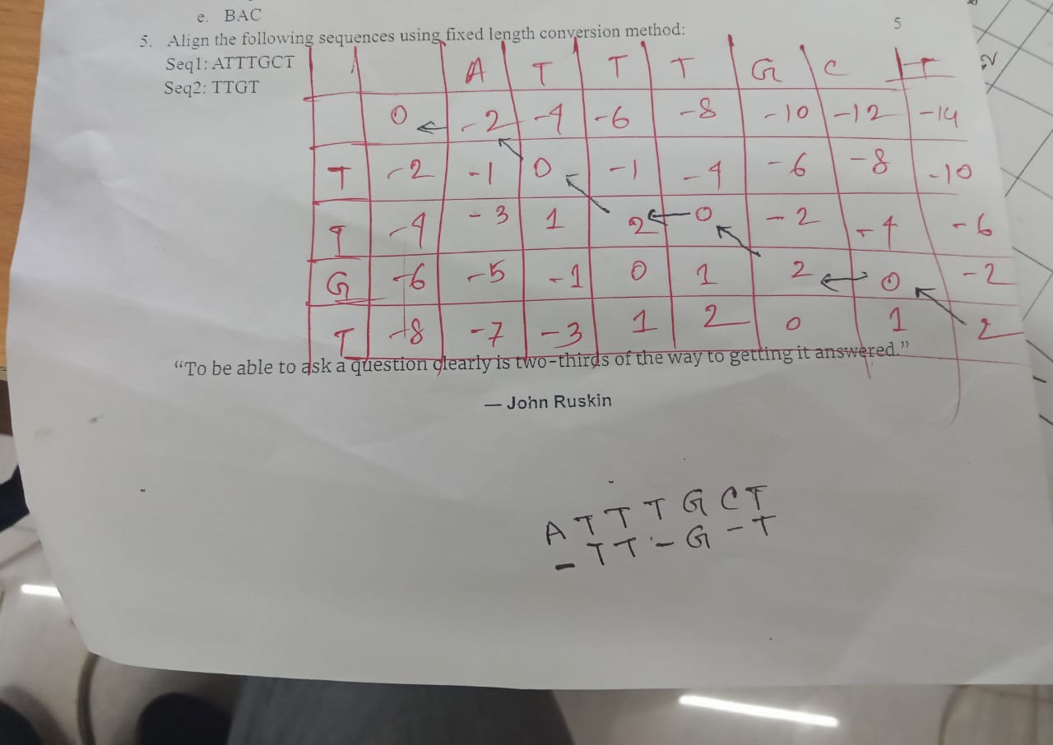

Slide 22
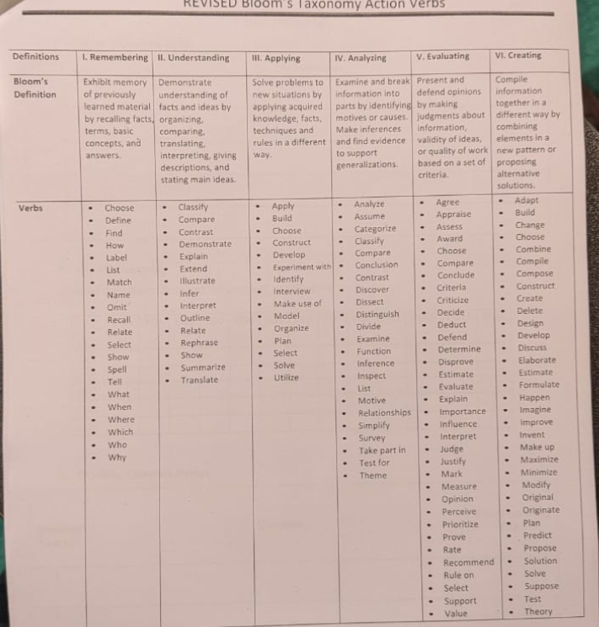

Slide 23
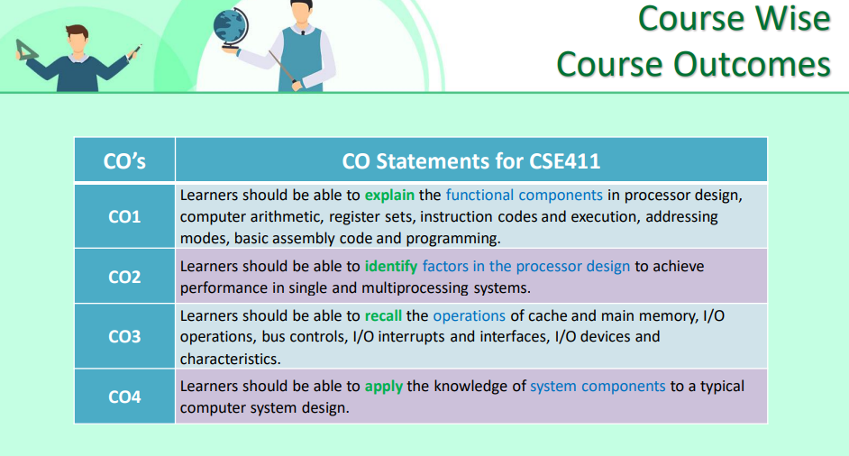

Slide 24
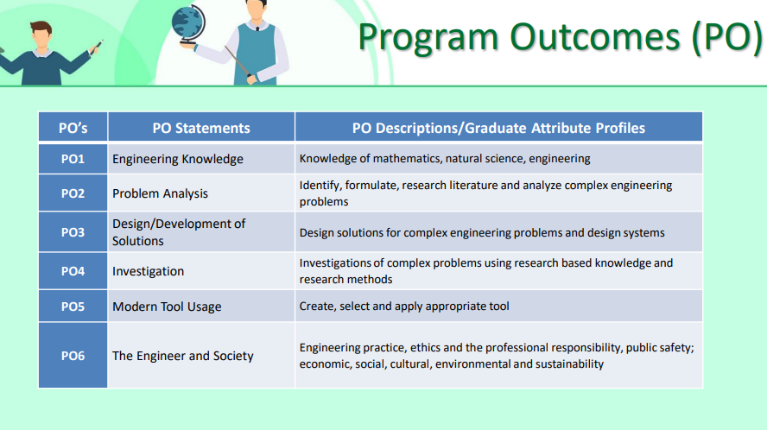

Slide 25
